Slide 1
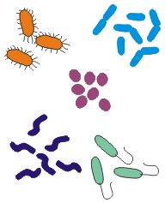
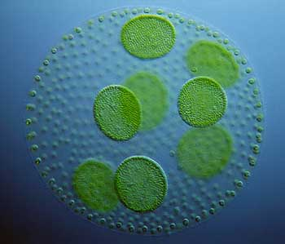
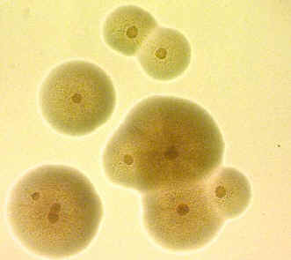
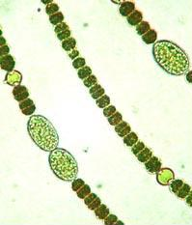
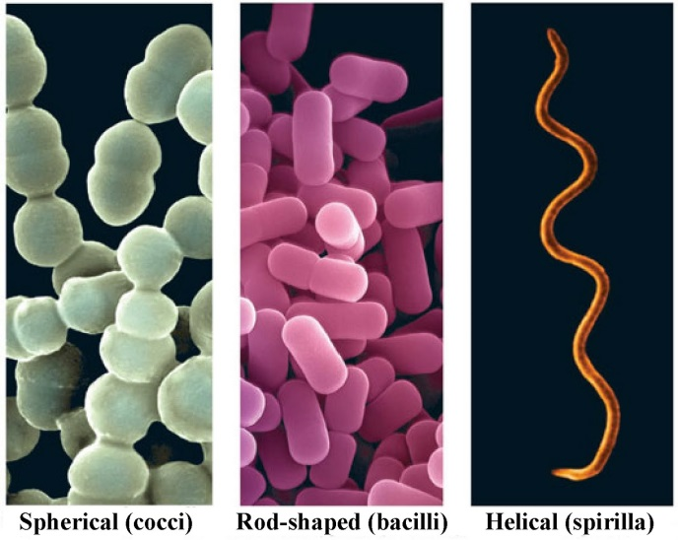
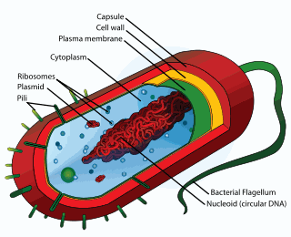
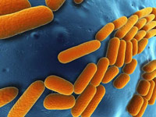
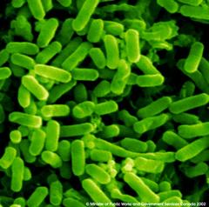
The important characteristics of the five kingdoms of Whittaker are as follows:
Kingdom MONERA
These organisms do not have a defined nucleus or organelles, nor do any of them show multi-cellular body designs.
Some of them have cell walls while some do not.
The mode of nutrition of organisms in this group can be either by
synthesising their own food (autotrophic) or
getting it from the environment (heterotrophic)
This group includes bacteria, blue-green algae or cyanobacteria, and mycoplasma..

Slide 2
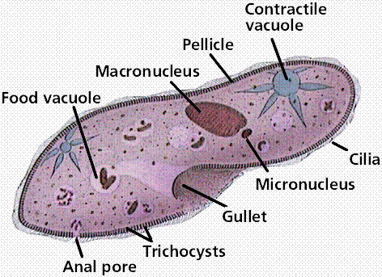
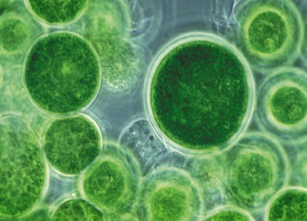
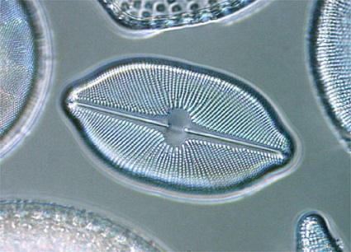
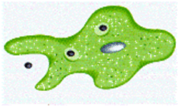
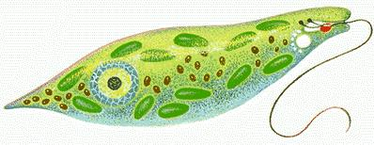
Kingdom PROTISTA
This group includes many kinds of unicellular eukaryotic organisms.
Some of these organisms use appendages, such as hair-like cilia or whip-like flagella for moving around.
attachments to the body
Their mode of nutrition can be autotrophic or heterotrophic.
Cilia
Examples are unicellular algae, diatoms and protozoans
Flagella

